Slide 1
Prototype Design Pattern
CS 655 Final Project
Mingjia Gong
2023.04.27

Slide 2
CONTENTS
Introduction
My project
How it works?
Advantages and Disadvantages

Slide 3
01
Introduction

Slide 4
Introduction
The Prototype Design Pattern is categorized as a creational pattern and provides a way to clone complex objects without coupling to their specific classes. This pattern enables us to create a new object by copying the original one and then modifying it as required, providing a mechanism to do so.
Prototype Design pattern is used when creating an object directly is expensive or requiring a lot of time and resources and you have a similar object already existing. Instead of directly creating an expensive object, this pattern involves creating a prototype interface that instructs the current object to be cloned.

Slide 5
Introduction
Shallow Cloning
The shallow copy of an object will have the exact copy of all the fields of original object. If original object has any references to other objects as fields, then only references of those objects are copied into clone object, copy of those objects are not created. That means any changes made to those objects through clone object will be reflected in original object or vice-versa.
Deep Cloning
Deep copy of an object will have exact copy of all the fields of original object just like shallow copy. But in additional, if original object has any references to other objects as fields, then copy of those objects are also created by calling clone() method on them or by creating new object and setting the original values in it. That means clone object and original object will be 100% disjoint. They will be 100% independent of each other.

Slide 6
02
How it works?

Slide 7
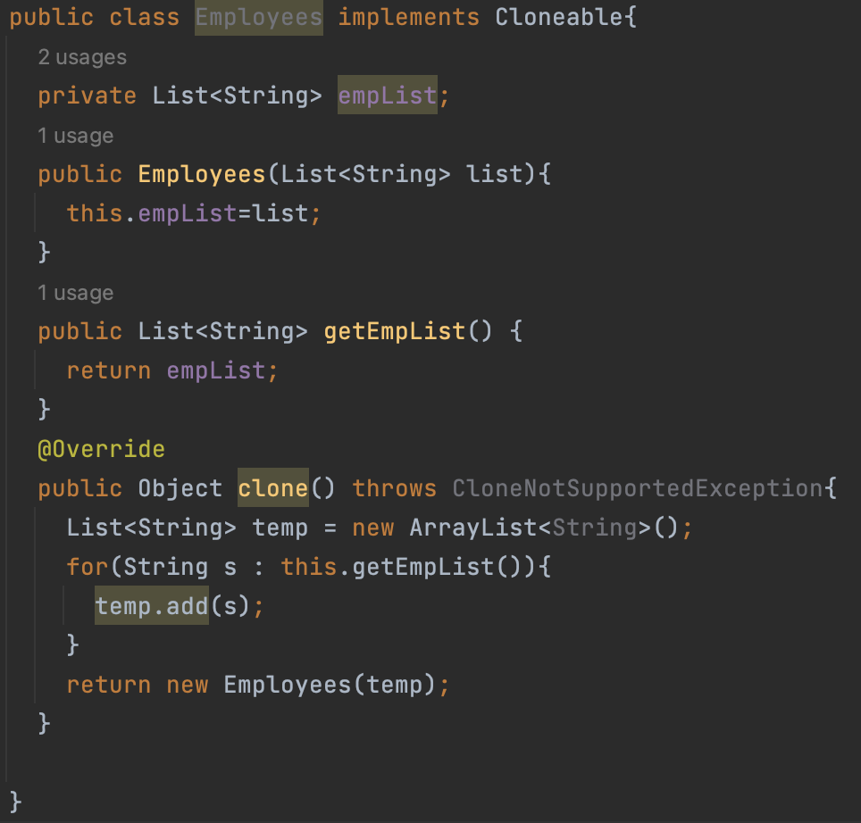
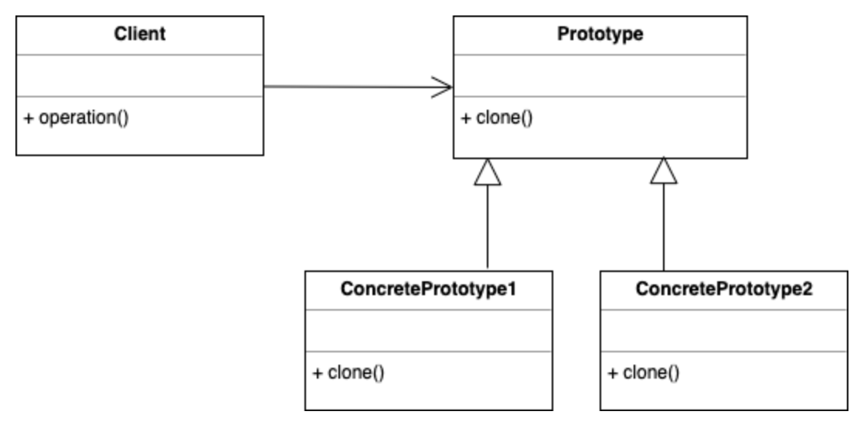
UML

Slide 8
03
My project

Slide 9
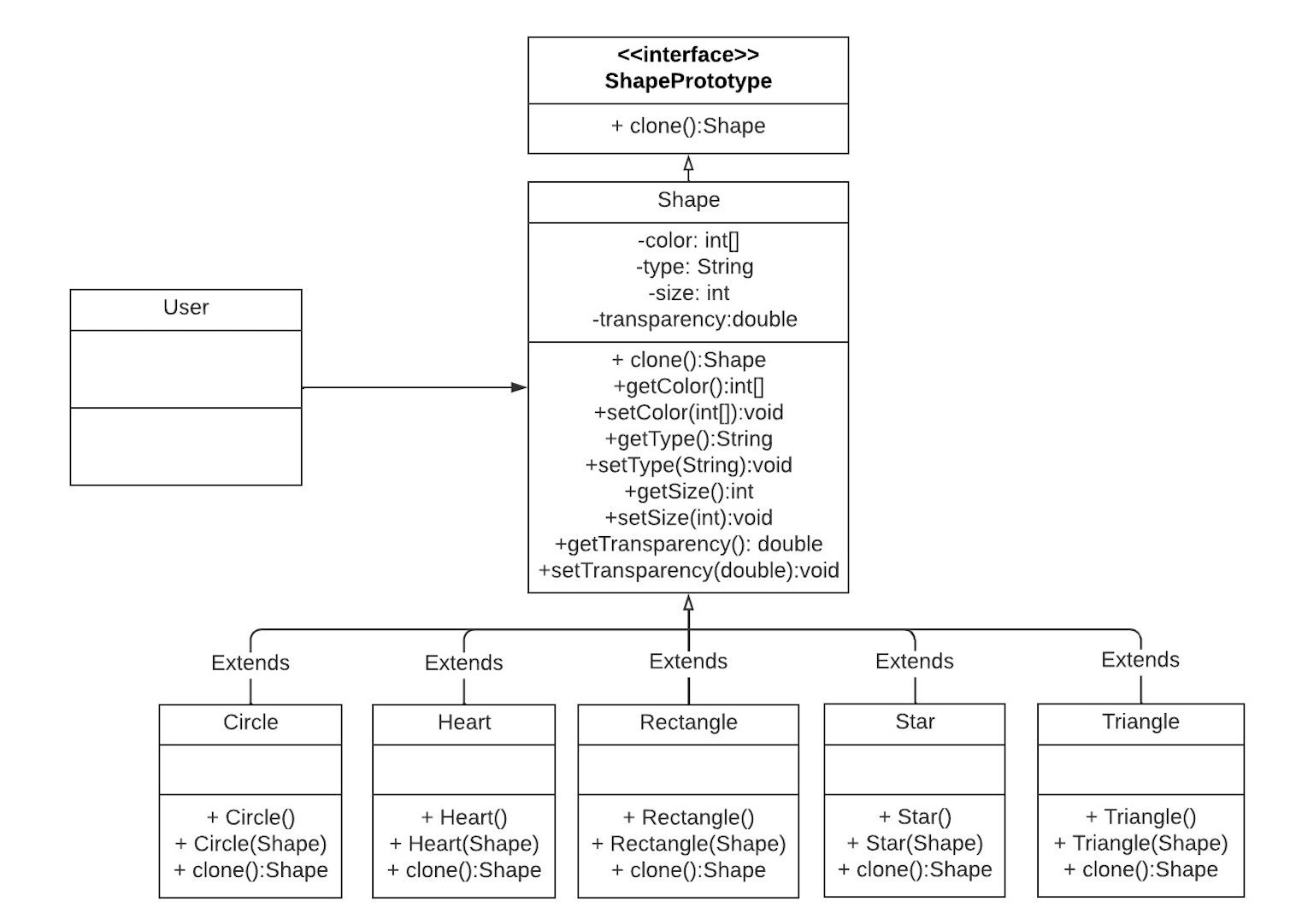
UML
This is a Java project that demonstrates the use of the Prototype design pattern to create new shape objects.
The project includes a Shape abstract class and five concrete classes Circle, Heart, Rectangle, Star and Triangle that extend the Shape class. The Shape class implements the ShapePrototype interface and provides a clone() method that allows creating new shape objects by cloning an existing shape.

Slide 10
04
Advantages and Disadvantages

Slide 11
Advantages and Disadvantages
Advantages
Reducing initialization: We can get new instances at a cheaper cost. The clients can get new objects without knowing which type of object it will be.
Simple copy process: It hides the complexities of creating objects. We only need to call clone() method, it is simple and easy to read.
Disadvantages
When the classes under consideration already exist, each subclass of Prototype must implement the clone() function, which can be complex. Also, when their internals involve objects that don’t permit copying or have circular references, implementing clone() can be challenging.

Slide 12

Thank you for watching
CS 655 Final Project
Mingjia Gong
2023.04.27

